Slide 1
Jason Lintern
Technology & Transformation
Health & Social Services Group
‘RIICHer and Stronger Together’
ADSS Cymru
Spring Seminar
21 March 2019

Slide 2
A Driver for Change
The Parliamentary Review: Stronger Together
Recognised that health & social care in Wales is unsustainable & advocated radical, transformational change including:
Bold new models of seamless care developed nationally, but co-produced & implemented regionally and locally
Adoption of the Quadruple Aim across Health & Social Care, including for R&D, innovation & (improvement) planning
Rationalisation & alignment of (improvement) support services across Health & Social Care in Wales

Slide 3
WG response to the PR 2018
long term future vision of a whole-system approach to health and social care.
Quadruple Aim supported by 10 practical ‘Design Principles’ is guiding our transformation agenda.
contains 40 practical actions – partnership approach with service providers - to achieve the vision.
unprecedented level of stakeholder input must not be lost

Slide 4
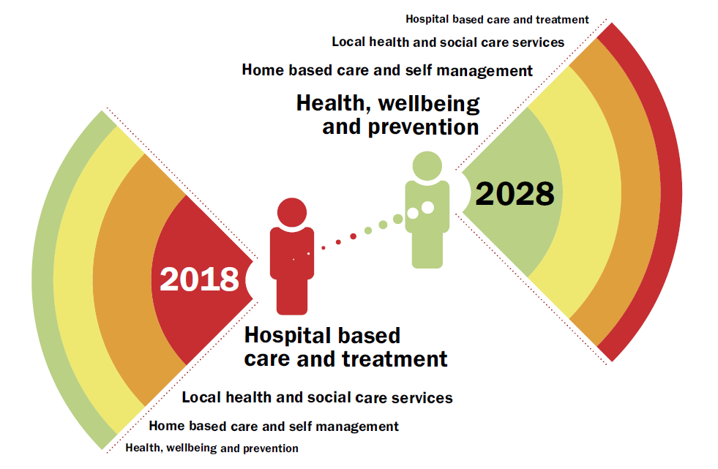

Slide 5
the imagining - what are we trying to bring together
Health and social care
New models of seamless local health and social care
To be driven by regional partnership boards
Better co-ordination of research innovation and improvement
In pursuit of quality and value
Link local innovation to national leadership and direction

Slide 6
the imagining -
where do we need to be
Transformation – a world leading integrated, high quality health and social care system, recognised alongside established systems such as the Canterbury health system model.
One System Approach - experts propose that an integrated, high performing system must have a total, single approach i.e. a common purpose.
Spread and Scale – enable transformation by spreading new ideas and effective practices at pace and scale locally, regionally & nationally.

Slide 7
the imagining - what will it look like
Research..… Innovation..… Improvement…..
Applied health & social care research
Health & Social Care Research
New technology and service development & adoption ___________
Innovative partnerships (public, private, academia & 3rd sector
Fully integrated, disruptive ‘one system’ approach leading to new models of care
Systematically generating ideas, identifying shared opportunities and securing IP
Exploiting new health & social care revenue streams
Whole system shift towards population health and integrated care
Whole
System Improvement___________
Whole
System Redesign
___________
System
led
change

Slide 8
Local Innovation leading to National Model

Slide 9
Research, Innovation & Improvement Co-ordination Hubs (RIICH):
Scope and Purpose
To act as agents for change through better co-ordination and alignment of a cluttered landscape
To be the flagship for integration, new way of working and consistent quality led approach to R,I &I
Not to undermine but to strengthen existing infrastructure
Deliver better quality and higher value together
The challenge is considerable…

Slide 10
Innovation
Improvement
National Innovation Centres
Bevan Commission
Improve-ment Hubs and Leads
QI Trained Staff
The Accelerate Programme
Life
Sciences
Hub Wales
Inst. Of Health Impr’ment
1000 Lives
PHW
HTW
AgorIP
Innovation Network for Health and Social Care in Wales
UHB
Innovation Hubs
Public Sector relations
Research, Innovation & Improvement Coordination Hubs
NHS Trusts 3
NWSSP
UHBs
7
R&I Strategic Partnership Groups
ADSS22
SCW
Universities
RPBs
7
Welsh Govt
SC R&D Strategy Group
Health & Care Research Wales
Wales School for Social Care Research
Core Funds £7bn + £2bn
£££
City and Growth Deals
£££
Research Centres
UHB Directors
R&D
Research Funding £££
Transf’n Fund & Prog
£££
Comp’n Funds
(WG/UKG/ HF/Nesta)
£££
Research
Funding

Slide 11
Research, Innovation & Improvement Co-ordination Hubs: Role
The Hubs cannot achieve alone but they can:
Provide a comprehensive and current overview of all research, innovation and improvement activity across the RPB area
develop a coherent strategic analysis of this activity
ensure that leaders, partners and stakeholders are informed and engaged
work with other regional hubs as a national network, with an emphasis on driving the adoption and spread of activity
work with national bodies such as the Life Sciences Hub, Health Technology Wales and 100 Lives Improvement

Slide 12
Research, Innovation & Improvement
Co-ordination Hubs Roll Out
Key Headlines:
WG Transformation Programme Fund to provide support of up to £250,000 p.a. for next 2 financial years to each RPB
To cover staff costs, engagement activity and data collection
Will be issuing grant offer with guidance by end March 2019
Completed proposals will need to be endorsed by the RPB and supported by partners

Slide 13
Stronger Together: A Revolution in Health & Social Care
Images and text like this if they are not full page.
Please avoid too many transition styles and swooping in of slides. Choose one type per presentation transition style so people know where they next slide is coming from.

Slide 14
Questions?
A diolch i chi. And Thank You.

